Slide 1
Capstone Exercise
Netflix Stock Prices for 2017- A look back

Slide 2
Overview
As the visualization developer for the stock price team I was responsible for the stock prices analysis and visualization of said stock prices. The charts used for review were the following :
Violin-plot chart
A Bar chart (side by side)
Scatter plot
Line charts

Slide 3
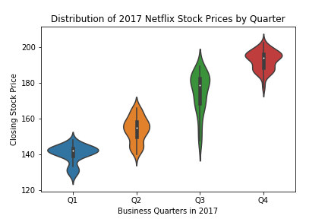
distribution of the stock prices for Netflix in 2017
Q3 was quite volatile but regained stability in Q4

Slide 4
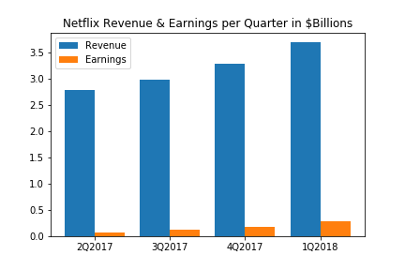
Revenue the Past 4 Quarters
Netflix showed consistent uptick in revenue quarter over quarter. The market was receptive to the subscriber additions and the shift from traditional cable subscribers to cord cutting. Earning were very modest but still trending in the right direction.

Slide 5
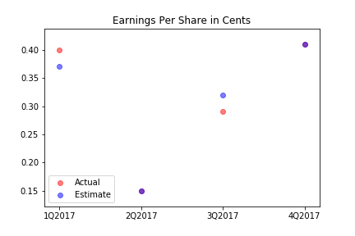
EPS Outlook
Netflix beat forecast in Q1 & Q3. A unusual lull in Q2 was followed by a nice uptick EPS. Forecasters seem to be able to get a handle on what to expect with stock and Netflix delivered.

Slide 6
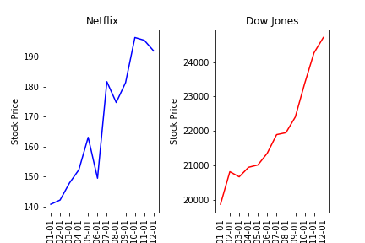
NetFLIX follows the Dow
Netflix shows great poise while the industry tries to make of this new type of binge entertainment. The volatility shows exposure to lack of content as well as competition in this space. Monthly Subscription reports will fuel price surges.

